Slide 1
School of Computer Sciences & IT
Name of the Students in the Group –
Yash Gupta (2019BTCS088),
Goutam Choudhary (2019BTCS032) and
Rishabh Verma (2019BTCS063) Faculty Mentor – Dr. Neha Gupta Madam
Name of Title - Optical Character Recognition (OCR) for Hindi Handwritten Text

Slide 2

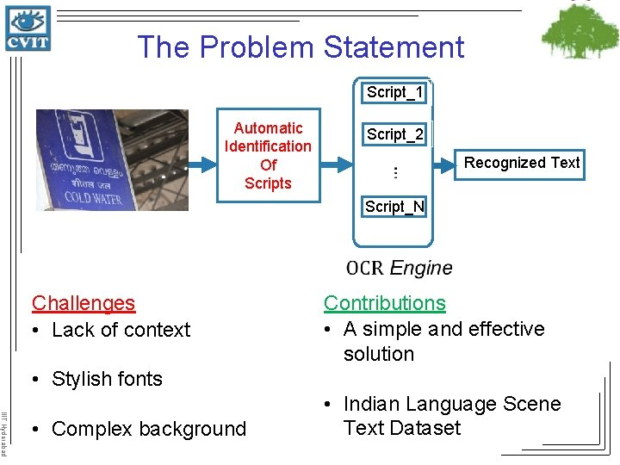
PROBLEM STATEMENT
We took this problem statement from manthan.nic.gov.in under IIC hackathon.
We have to create an OCR Engine which has capabilities to perform OCR on Hindi Handwritten Text for Bureau of Police Research and Development.

Slide 3
What is Optical Character Recognition (OCR)?
Optical Character Recognition (OCR) is a process of converting printed or handwritten scanned documents into ASCII characters that a computer can recognize.
In other words, automatic text recognition using OCR is the process of converting an image of textual documents into its digital textual equivalent.
The advantage is that the textual material can be edited, which otherwise is not possible in scanned documents in which these are image files.
The document image itself can be either machine-printed or handwritten, or a combination of the two.
Computer systems equipped with such an OCR system improve the speed of input operation, decrease some possible human errors and enable compact storage, fast retrieval and other file manipulations.
The range of applications includes postal code recognition, automatic data entry into a large administrative system, banking, automatic cartography and, when interfaced with a voice synthesizer, reading devices for the visually handicapped.

Slide 4
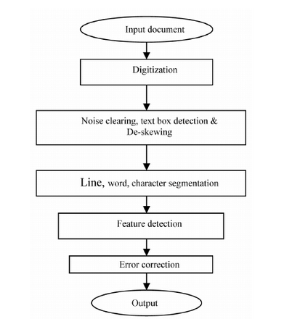
Overview of Hindi OCR System
An OCR system should usually perform the following tasks:
a) Text Digitization
b) Gray Tone to Two Tone Conversion
c) Noise clearing
d) Text Block Identification
e) Skew Correction
f) Line and Word Detection
g) Character Segmentation
h) Features Extraction
i) Character Recognition
j) Error Correction

Slide 5
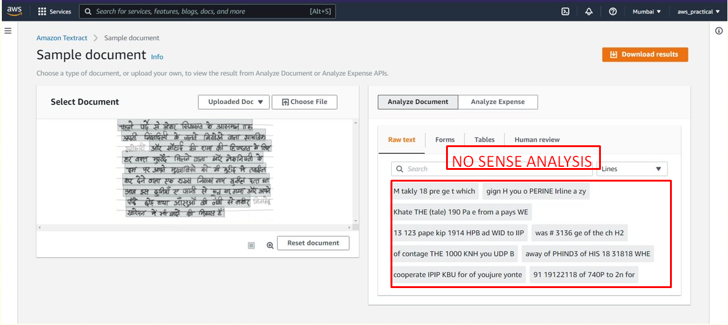
AWS TEXTRACT ML SERVICE => 100% FAILED

Slide 6
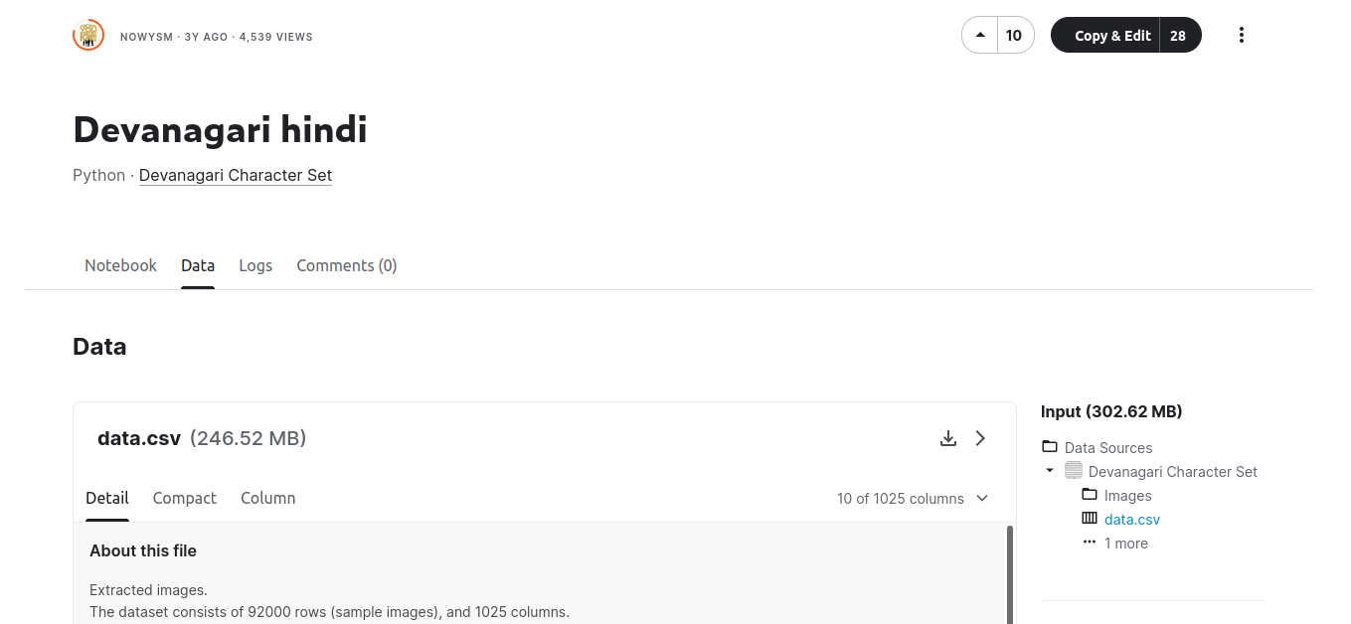
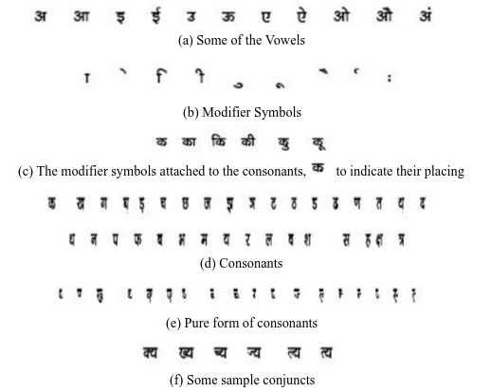
HOW TO SOLVE THIS PROBLEM?
Step 1: We took 'Devanagari Hindi' dataset from Kaggle as well as real world Dataset from student Hindi Notebook. Step 2: As this is a Classification Problem, having Multi-Class Logistic Regression. Step 3: So we implemented Deep Learning, with the help of CNN Algorithm. Step 4: We used multiple libraries
Python 3.9 ; Anaconda Package Manager 2021.11
Jupyter Notebook 6.4.7
OpenCV Library 4.5.5
Keras Library 2.7.0
Pandas Library 1.4.0
Matplotlib Library 1.3.1

Slide 7
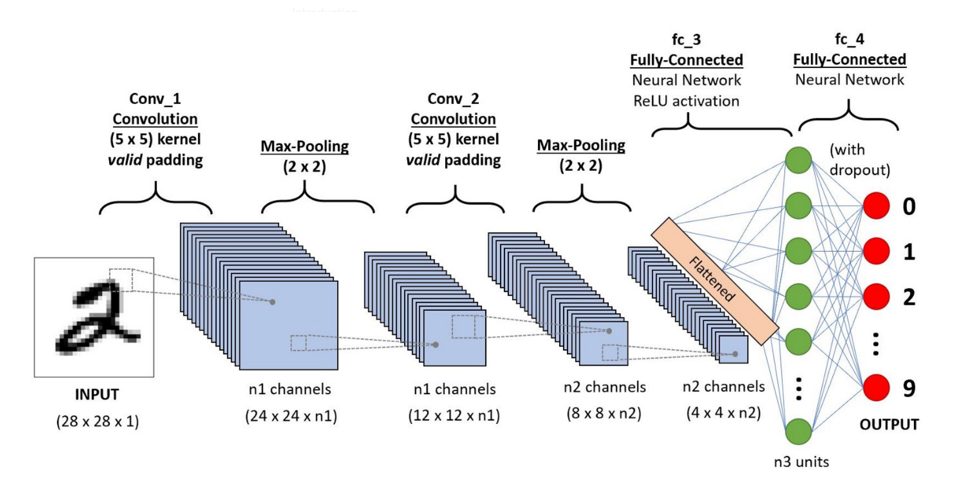
WHAT IS CNN ALGORITHM?

Slide 8
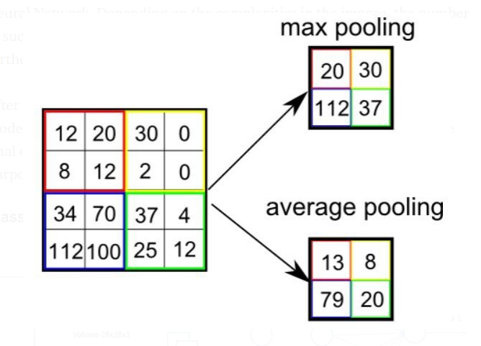
Working of CNN Algorithm
This is how padding works in CNN. Convolution Operation with Stride Length = 2
This is pooling layer works in CNN. Here 3x3 pooling over 5x5 convolved feature.
Types of Pooling

Slide 9
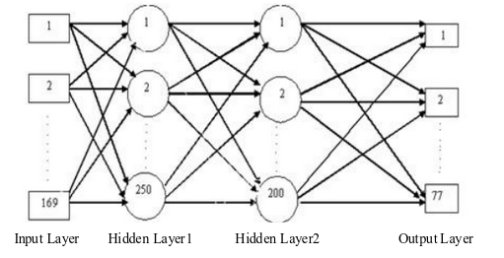
Our Artificial Neural Network
A Neural Network with total 4 layers, 169 neurons in I/P layer, 250 and 200 neurons in hidden layers & 77 neurons in O/P Layer.

Slide 10
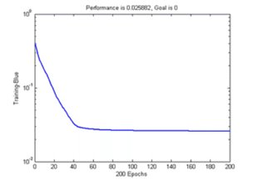
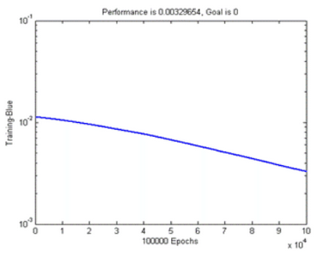
Epochs done in our model
ANN learning curve using learning rate 0.9 for first 200 epochs
ANN learning curve using learning rate 0.9 for 100000 epochs (from 50001 epochs to 150000 epochs)

Slide 11
PROPOSED METHOD FOR FEATURE EXTRACTION AND CLASSIFICATION
Feature Extraction Methods
Histogram of projection based on mean distance
Histogram of projection based on pixel value.
Vertical zero crossing
Classifier Tool
Scaling
Training our NN Model
Testing our NN Model

Slide 12
RESULTS ANALYSIS
We tested our classifier on various printed Hindi documents and gathered the results. In fact the testing was done at two levels: individual letter level and paragraph level.
Robustness of Classifier - To test the robustness of the classifier we gradually increased the distortion in the input character images and observed the recognized characters thereof.
Result Details of Feature Extraction - From the results we can conclude that the error at classification level is negligible. This is, indeed, due to good selection of the features.
Segmentation Analysis - Our segmentation approach is a hybrid approach, wherein we try to recognize the parts of the conjuncts that form part of a character class.

Slide 13
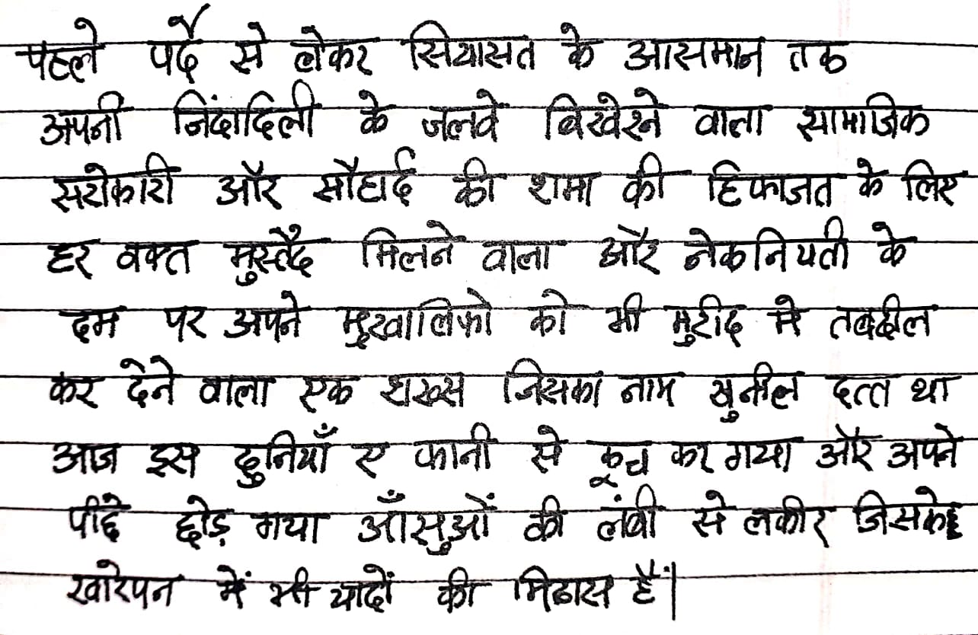
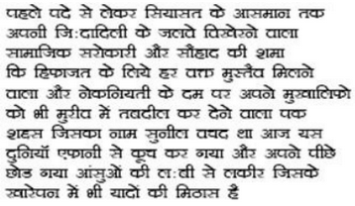
CONCLUSION AND FUTURE WORK
The experimental results illustrate that the artificial neural network (ANN) concept can be applied successfully to solve the Hindi optical character recognition problem.
There are many variations of factors that affect the performance of the developed Hindi OCR software.
The recognition rate of the OCR with the real Hindi document is quite high as shown in the results section.
However, other kinds of preprocessing and neural network models may be tested for a better recognition rate in the future.
The other future enhancement that can be incorporated in the work is to use a dictionary of words to correct the output. Certainly this will improve the performance.
In future, speech synthesizer can be integrated with the OCR with the aim of making a system for reading aids to the blind.
Scanned Devanagari Script as Input
OCR Output

Slide 14
Thank you

